Slide 1
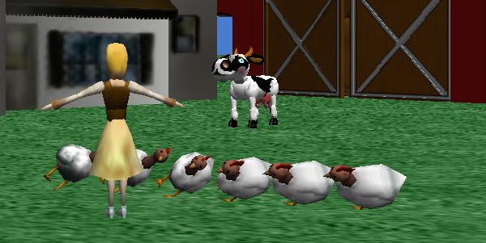
Tutorial for Arrays and Lists
By Ruthie Tucker
Under the direction of Professor Susan Rodger, Duke University 2008
www.cs.duke.edu/csed/alice/aliceInSchools

Slide 2
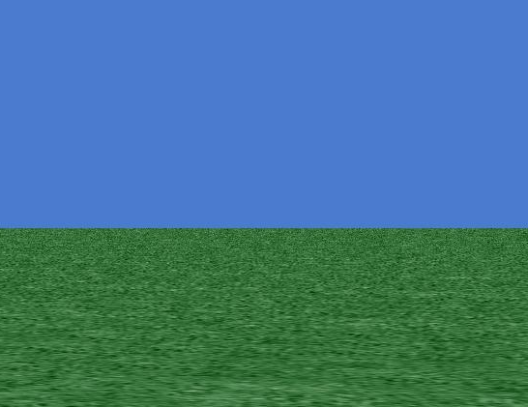
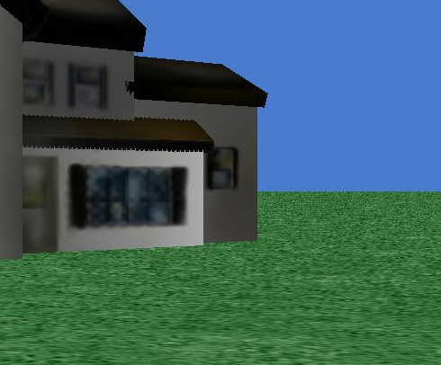
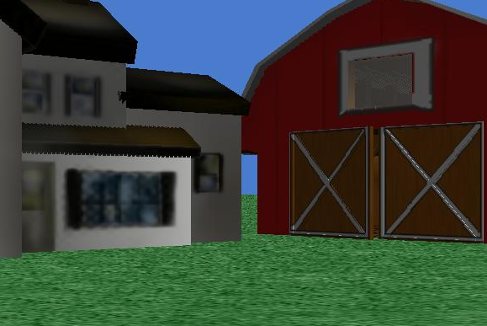
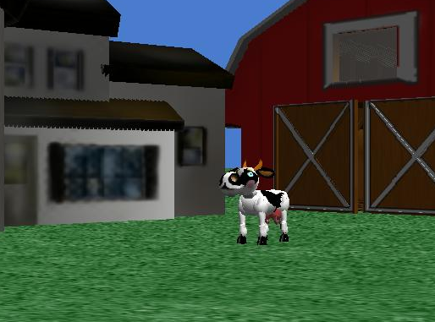
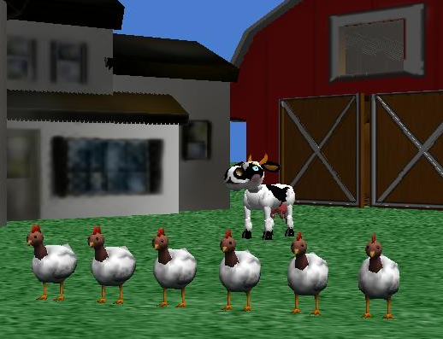
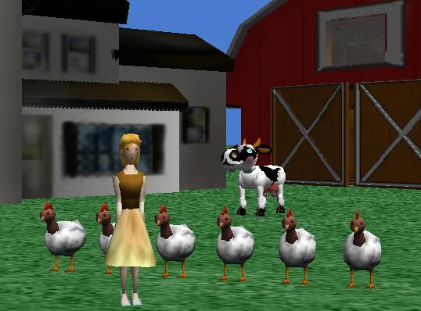
The Characters

Slide 3

Setting up the background
three methods have already been given to you.
World.OpeningScene *** add to the student one
Cinderella.Conduct
Cinderella.end
These methods will allow Cinderella to conduct the chickens while they dance.

Slide 4
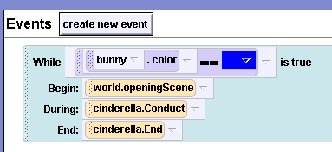
Setting up the Background
We are going to execute these methods in a BDE event in our events editor.
We will put an invisible bunny in the background that changes colors to execute the rest of the BDE.
This is how your event should look

Slide 5
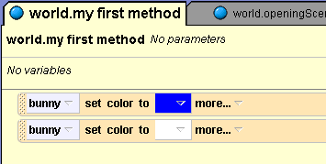
Setting up the Background
This is how your world.my first method should look right now.

Slide 6
Animating the chickens
Now we are going to animate our chickens
To do this we will need to use two things
A list
And an Array

Slide 7
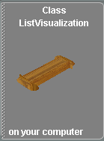
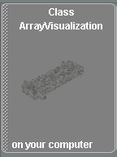
Getting Started
What is a List?
A list is simply a way to organize information.
What is an Array?
An Array is a structure for collecting and organizing objects or information of the same type into a group.
In Alice Arrays and classes are visual objects to be dropped into your world

Slide 8
Side Note
Glitch in Alice
Alice cannot compute your world if you put the same objects in a “List Visualization” as an “Array Visualization”.
I will demonstrate how to use the “List Visualization” later, but for now we are just going to make a regular list.
However, you can use a list without the actual Visualization, if you also want to use an “Array” in your world

Slide 9
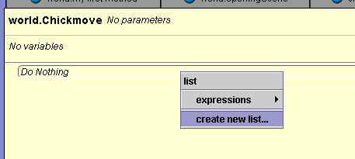
Making a List
Create a world level method named “ChickMove.”
Drag the “For all Together” Button onto the method editor.
Select “Create new list.”

Slide 10
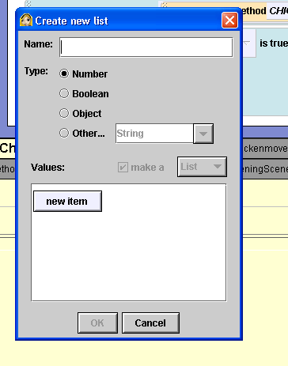
Making a List
A box will pop up for you to enter in the items on your list.
Name it “ChickensDance Together.”
Enter in each chicken, keeping in mind that the entries start at slot ‘0’.

Slide 11
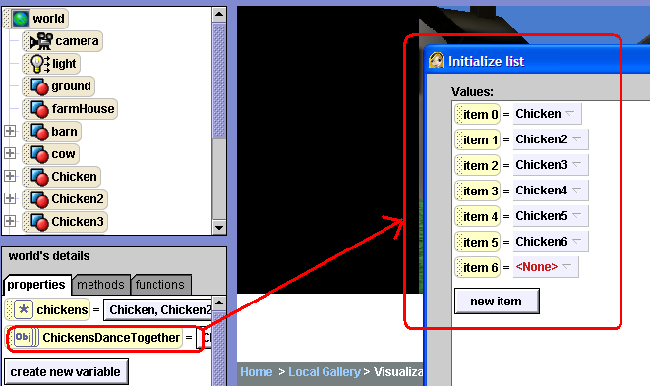
Lists
This is how your box should look.

Slide 12
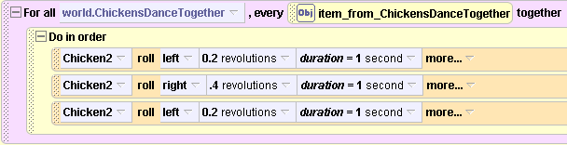
Lists
We want the chickens to roll left and right together.
Above is the code to have one chicken roll left and then right
I selected Chicken 2 but any chicken will work
Put all of this code in your World.Chickmove method

Slide 13
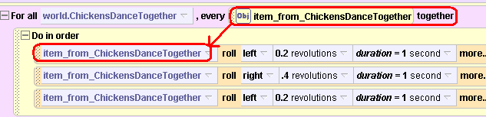
Lists
Now drag the tab labeled “item_from_ChickensDanceTogether” over the box that was previously labeled “Chicken 2.”
Repeat this for each command to make the chicken roll

Slide 14
Lists
Now we have programmed the List to have all the chickens roll left and then right at the same time.
But what if we want them to do something, one at a time?
This is where ‘For all in order’ comes in.
We will now program the chickens to kick up their left leg, one at a time.

Slide 15

Lists
Open a New method named “KickUpLeg” and create a new parameter called “WhichChicken.”
Click on the “For all in order” tab at the bottom of your screen and drag it into your method
Side Note: Always make sure it is an “object” parameter

Slide 16
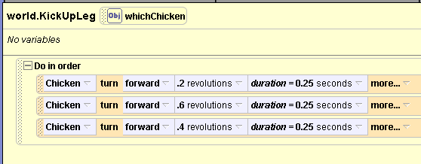
Lists
First write the method for the chicken’s leg to kick, using the entire chicken as the place holder.

Slide 17
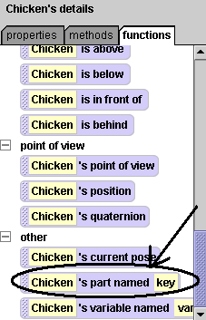
Part named Key
Click on world level functions and select a function labeled “Parts named key.”
Replace each “chicken” with this function in your method.

Slide 18
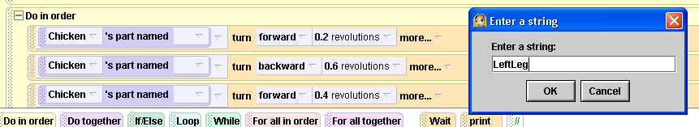
Part Named Key
Then, drag the parameter ‘whichChicken’on top of ‘Chicken’.
For each white box select the arrow down key and hit “other”
A box will appear for you to type.
You must get the syntax exactly correct.
Type in “LeftLeg”

Slide 19
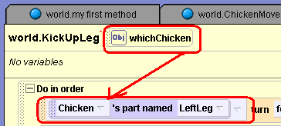
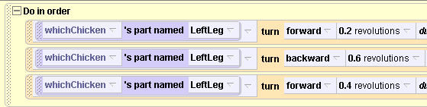
Part named key conclusion
Finally take your object parameter and drop it back in where it says chicken
Your code should look like the picture below when you are done

Slide 20
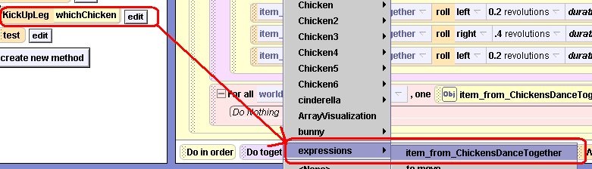
Lists
Now go back into your “chickmove” method and drag your “KickUpLeg” method into the “For all in Order” space.
Select Expressions and then Item_from_ChickensDanceTogether

Slide 21
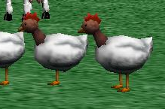
Lists
Now that this portion is programmed all the chickens will roll right and then left at the same time for the “Together Functions” and kick up their legs one at a time for the “For all in order Functions”
This saves lots of time and lines of code
Imagine if we had to program each chicken to do this individually!

Slide 22
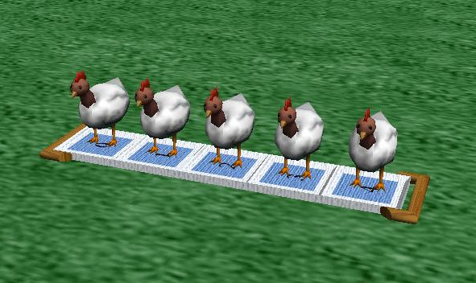
Side note on List Visualizations
If you are not also using an Array and would like to visualize your list you can select the list visualization class from the Visualizations folder
DO NOT DO THIS RIGHT NOW OR IT WILL MESS UP THE LIST YOU JUST CREATED
After entering in all of the Chickens they should be aligned in a row that looks like this.
If you “Set is Showing to False” the List Visualization will disappear, but it is still there.

Slide 23
Arrays
Lists are great for coding a group of objects to all do something.
But what if we want to code only some of the objects in our group to do something.
This is where Arrays come in.
The following slide will show the place that you need to go to find the Array. It is called “Array Visualization”.

Slide 24
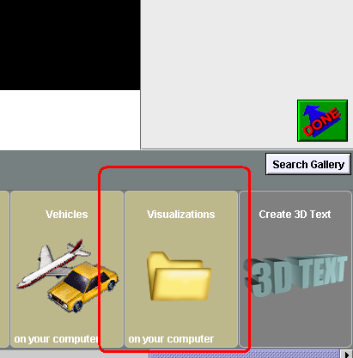
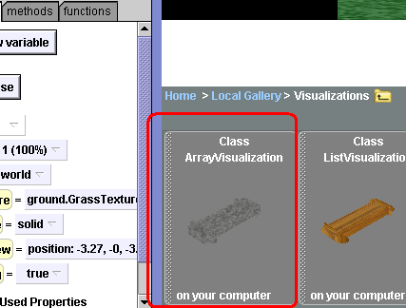
Starting the Array
Go to add objects
Select the folder at the end of the list entitled “Visualizations”.
The first object on the left should be a class called “Array Visualizations”.
It should look like a strip of concrete.
Select it

Slide 25
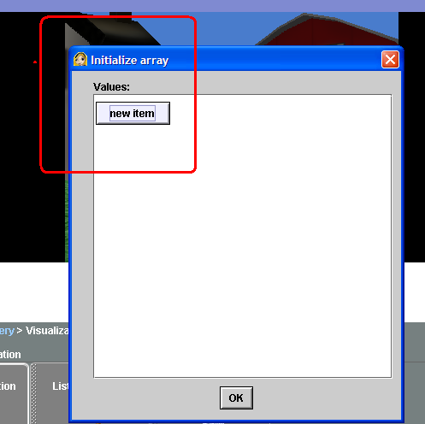
Starting the Array
We are going to use our Array for the chickens
When you add the Array to your world this box called “Initializing Array” will appear
Count the number of chickens you have and select the button “New Item” for that many.
Remember it will start at 0

Slide 26
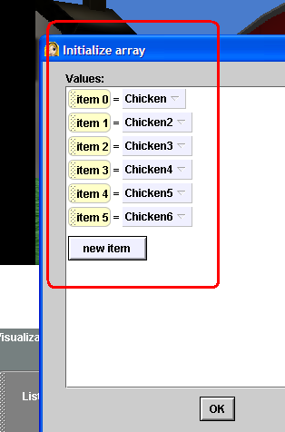
Array continued
Once you have entered all of your chickens into the Array your screen should look like this.
If it does, click ok. If not, hit “undo” at the top left and try again
Once you hit ok your chickens should be neatly lined up on the Array.

Slide 27
Arrays
Side Note: As with the list you can set “Is showing to False” to hide your Array Visualization so that the chickens do not look like they are standing on anything.
However, the Array is still there and functional

Slide 28
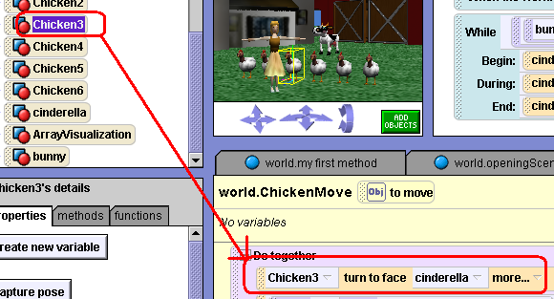
Arrays Continued
We want all of our chickens to turn to face Cinderella
Code the simple method first

Slide 29
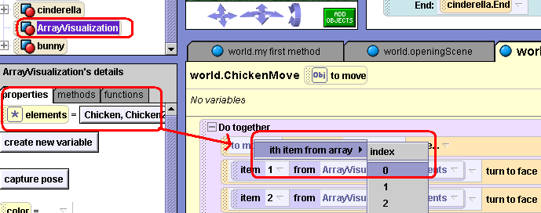
Arrays Continued
Now go to Array Visualizations, properties, and drag the “elements” tab down to your parameter.
Select 0, repeat this step for each chicken in your Array.

Slide 30
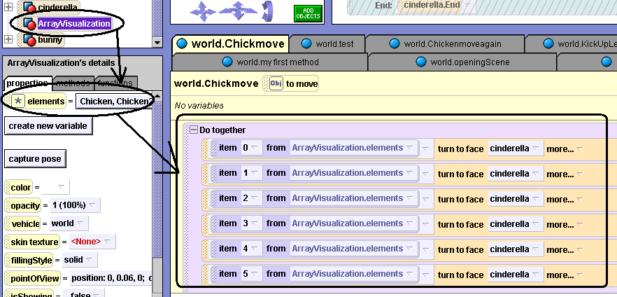
Array Continued
Note the small circle on the left labeled “elements.”
This is how your array will appear in your tool bar after you have entered it in
Select each number down the line, till you have all of your chickens in the code.

Slide 31
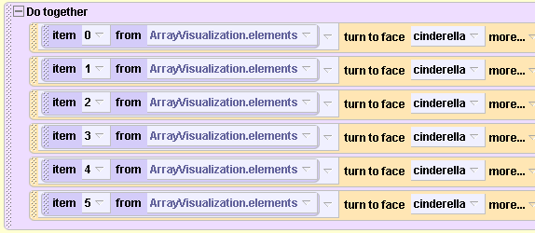
Complete Turn to Face Code

Slide 32
More with Arrays
Play your animation, the chickens should all turn to face Cinderella.
Now, lets try separating out the commands
We want every other chicken to move up and every other chicken to move down. The first step is to code the simple process of moving up and down with any one of the chickens.

Slide 33
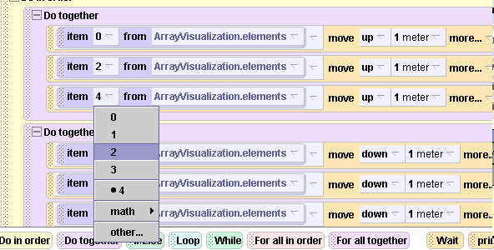
Getting Chickens to do Different Things
when you add the Array visualization, simply choose certain numbers to do a task rather than all of them.
Then you add another task and set the rest of the items in the Array to that task

Slide 34
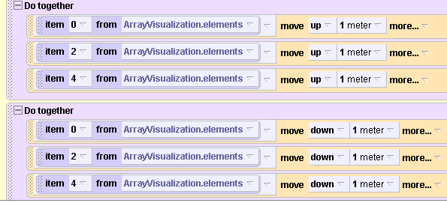
Arrays Continued
This is the beauty of the Array
It allows you to only move selected objects in your Array
Whereas with the List you must move everything
Once you have finished plugging in the Array your code should look like this
Note that only chickens 0, 2, and 4 are going to move.

Slide 35
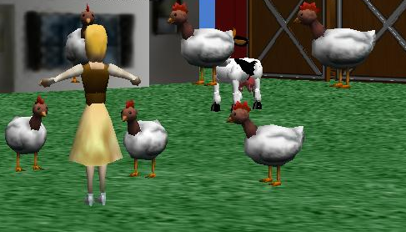
Arrays
Now play it.
Note how Chickens 0, 2 and 4 are moving down while chickens 1, 3, and 5 are moving up.
You can program each chicken individually or in any number that you want.

Slide 36
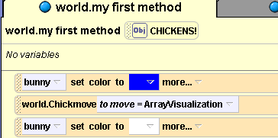
Arrays
Finally, lets drop our “chickmove” method into our world.myfirstmethod. So that it will play in our animation.
For the parameter, select “ArrayVisualization.”

Slide 37
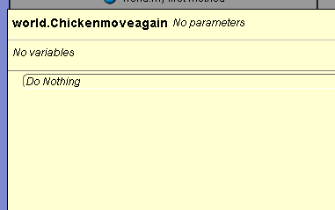
The Complicated Loop
Now we are going to learn a faster way to make Array’s work.
Lets write a new method called “Chicken move again”

Slide 38
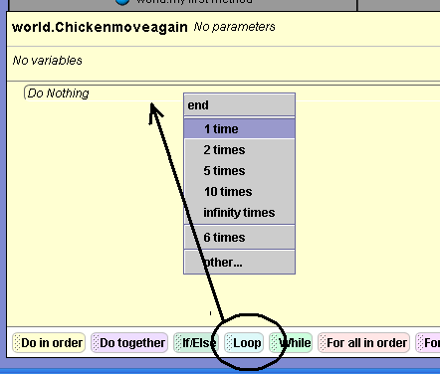
The Complicated Loop
- First drag in a regular loop and select 6 times

Slide 39
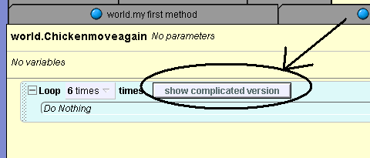
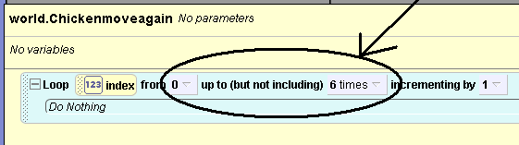
The Complicated Loop
Now click on the button that says, “Show complicated version.”
Your loop should now look like this.
This means that it will loop through chickens in slots 0 – 5.

Slide 40
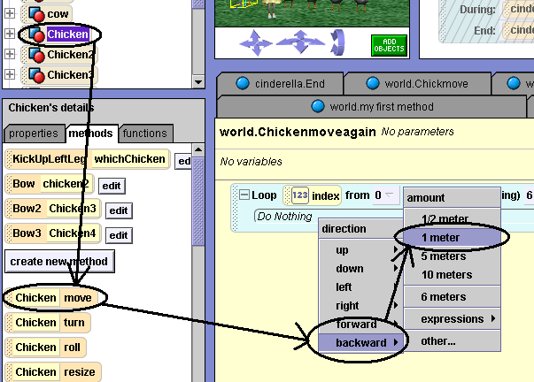
The Complicated Loop
Now we will put a simple method in our world that tells “chicken” to move back 1 meter.

Slide 41
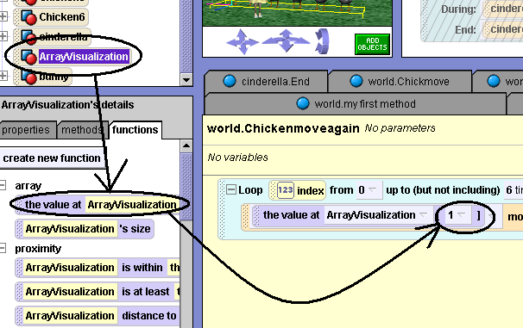
The Complicated Loop
Go to the functions tab of your Array visualization.
Drag the function labeled “the value at array visualization” over and drop it on top of “chicken.”
The number you pick doesn’t matter, it’s just a place holder.

Slide 42
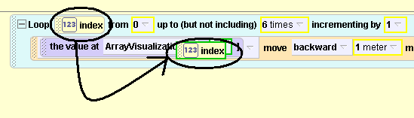
The Complicated Loop
Now take the “123 Index tab” and drop it over the number that was your place holder

Slide 43
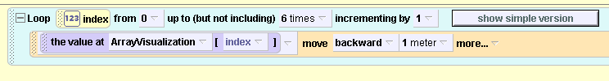
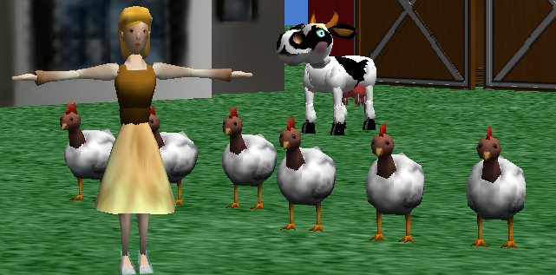
The Complicated Loop
Once you have done that try playing your “chickenmoveagain” method.
Your chickens should move back one at a time.
As you can see this greatly shortens the amount of code that you need to write methods with arrays.

Slide 44
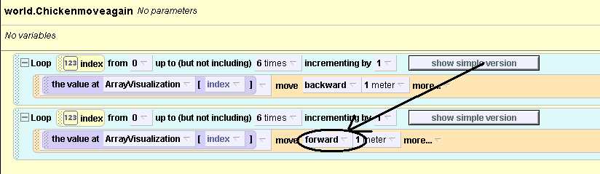
The Complicated Loop
Make a copy of your loop and reverse the direction.
This time they should go forward.
Now try playing your world again

Slide 45
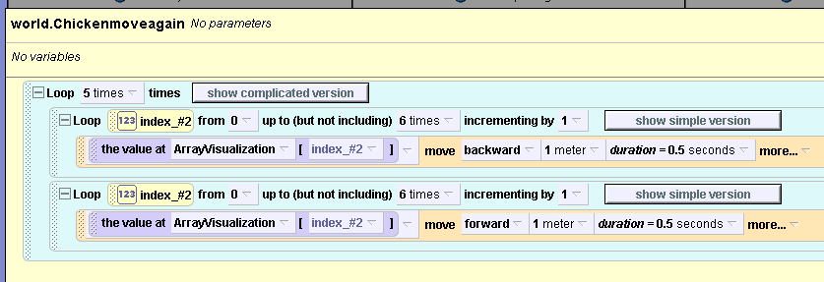
The Complicated Loop
Play your complete method when you are done.
Now lets make the animation a little bit more fun by speeding it up and putting a loop around the entire thing.

Slide 46
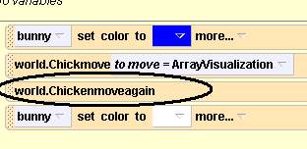
The Complicated Loop
Now lets put this new method inside of world.myfirstmethod.
Watch your chickens dance.

Slide 47
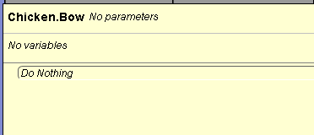
Finishing touches
To finish up we are going to review lists and have the chickens bow.
Create a new method under chicken and name it “Chicken.Bow”

Slide 48
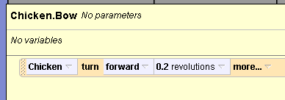
Finishing Touches
We will now code the chicken to turn forward 0.2 revolutions.

Slide 49

Finishing Touches
Go to functions and find “parts named key.”
Drag it on top of chicken

Slide 50

Finishing Touches
Name the part “Neck”
Make sure the syntax is correct.

Slide 51

Finishing Touches
Create a parameter and name it “WhichChicken”
Make sure its an object parameter

Slide 52

Finishing Touches
Finally, call your bow method at the end of “world.myfirstmethod.”
Play your world
That’s all folks!!!!!!!!!

Slide 53
Recap
When we put all of these elements together you can see how Lists and Arrays can be used interchangeably to animate your Alice world.
The ‘For all together’ command in Lists allows you to animate a group of objects to do something together.
The ‘For all in order’ command in Lists allows you to animate the whole group of objects to do the same thing, but one at a time.
The Array allows you to have a group of objects do different things.

